Slide 1

NUMERIST MAY ’22 DATA CHALLENGE
By Olalekan Olujobi

Slide 2

OUTLINE:
Introduction
Preparation & Processing
Analysis
Recommendations

Slide 3



Introduction
Company ABC currently sells Holidays (vacations) through an online website. The purpose of this analysis is to uncover insights from historical data collected from the website through user visits in 2017, identify areas requiring improvement and make recommendations to help make the business more profitable.

Slide 4
The dataset contains a total of 8 columns and 2441 rows
The columns are listed as:
Landing page: URL of the website’s landing page
Month of Year: month and year of the recorded event
Sessions: number of sessions for the period
New Users: number of new users recorded for the period
Bounces: number of bounces on the page (users that left without clicking another page)
Page Views: number of page views for the period
Avg Session Duration: mean time spent on the page by all users for the period
Transactions: number of transactions recorded within the period

Slide 5
Preparation and Processing
The Original dataset was copied to a new workbook before performing analysis.
The landing page column was split into different columns: “Landing page 1”, ”Landing page 2”, ”Landing page 3”, and “Landing page 4” using the delimiter ‘/’ to independently show the different website pages.
The ‘month of year’ column was formatted into date format indicating month and year (‘mm-yyyy’).
The average duration time was formatted to record duration in minutes and seconds spent by users on the web pages.
Rows with null values in numeric columns were replaced with 0 to aid calculations.
A new column titled ‘pages’ was generated to record the number of pages accessed per recorded time

Slide 6
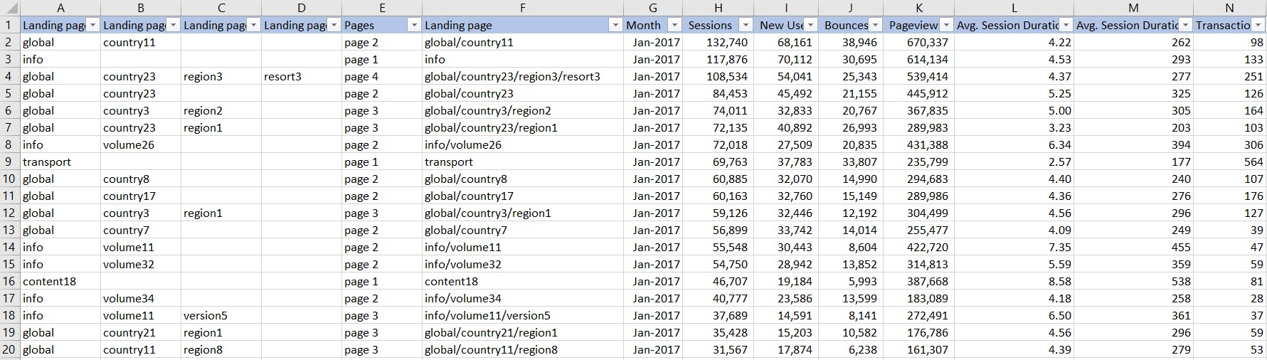
Processed Dataset

Slide 7
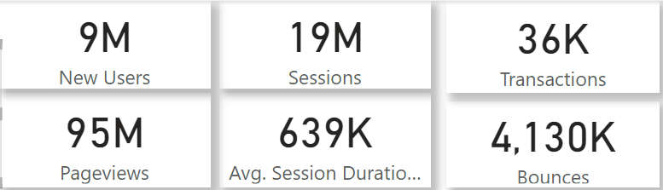
Analysis
Bounce Rate = Total Bounces / Total Page Views = 4.34%
A Bounce rate of 4.34% indicates good user interaction with the website, visitors seem to be spending time on the landing pages and clicking through other pages.
Transaction Rate:
Comparing the total number of transactions in the period to new users recorded, one transaction can be said to have occurred per 254 new users. Less than 0.5% of new users transacted. This shows that there is a need to convert more leads into actual customers.

Slide 8
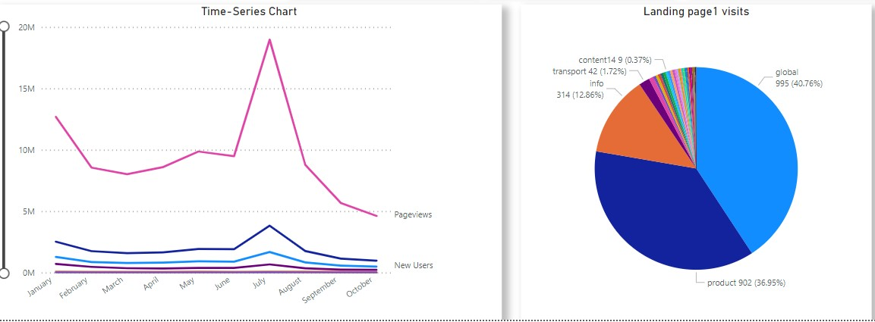
Activity on the Website peaked in the month of July which seems to be about the start of Summer, online research supports the thought that a lot of people take their vacations in July, August, September and December.
The ‘Global’ landing page received most user visits recording 40.76% of total Landing page 1 visits, followed by ‘Product’ at 36.95%, then ‘info’ at 12.86% before others.

Slide 9
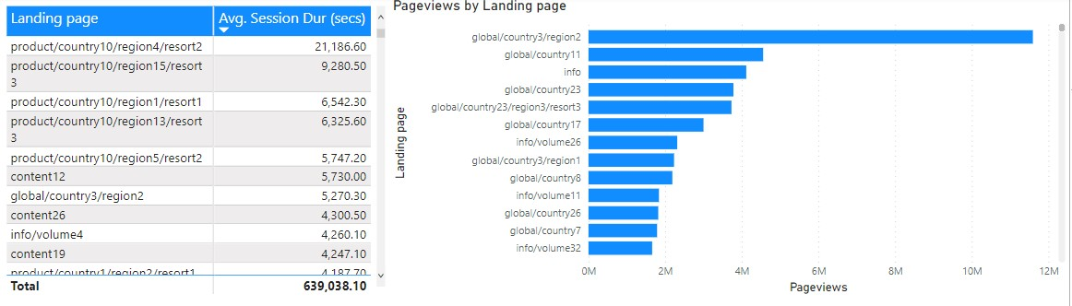
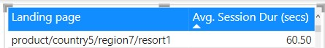
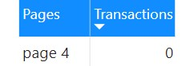
The most time spent by users in the period was on landing page, ‘product/country10/region4/resort2’ while landing page ‘global/country3/region2’ witnessed more page views.
Landing page ‘page/country5/region7/resort1’ witnessed the least page visits at 60.5 seconds avg session duration and no transactions.

Slide 10
Recommendations
Based on Analysis carried out on available data, the below conclusions have been drawn:
The website should have all of the most visited Landing pages 1 (global, info and products) embedded into one while different sub-pages can then be used to hold the different information.
Data for the remaining two months of the year (Nov and Dec) should be collected to support already observed trends and facts or help realize more insights.
Complexity or difficulty in completing transactions should be investigated and optimized if any is found to allow users carry out more transactions.
Quick reviews / responses should be collected from customers when they try to leave the website (for example: Did you find what you were looking for: Yes / No?) to know what pages held customer-useful information more.

Slide 11
Recommendations
Promotions should be run through the month of June and July yearly to convert more new users into transacting customers.
Discounts should be given for early bookings to reduce traffic at peak periods and encourage more transactions all year round.
Information currently on page ‘global/country3/region2’ should be inspected to ascertain the reason for its massive views and translate same type of insight / information across other pages.
Pages with the least views can be expunged and have the information they hold hosted on other pages to tame redundancy and optimize the website.

Slide 12

Thank you
Name: OLALEKAN OLUJOBI
Email Address: implilekan@gmail.com
Website: https://implilekan.github.io/portfolio

Slide 13
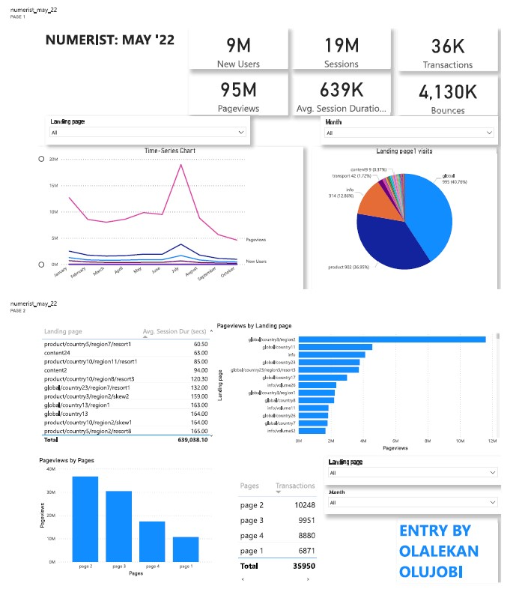
Power Bi Dashboard Screenshot

